Slide 1
Building a Basic Visual Analytics System
Vitaveska Lanfranchi
Suvodeep Mazumdar
Tomi Kauppinen
Anna Lisa Gentile
Update material will be available at http://linkedscience.org/events/vislod2014/

Slide 2
Agenda
Gather Social Media
Extract relevant information
Store for later processing
HTML/JS
Querying data stores
Visualising result sets

Slide 3
Paradigm for visual data exploration
Overview first, zoom and filter, then details-on-demand¹
Analysis first – show the important – zoom and filter, and analyze further – details on demand²
Social Media, Crisis Management
Identify topics, monitor, explore, details-on-demand
1- B. Shneiderman. The Eyes Have It: A Task by Data Type Taxonomy for Information Visualizations. In the Proceedings of the IEEE Symposium on Visual Languages, pp. 336-343, 1996.
2- D. Keim. Scaling Visual Analytics to Very Large Data Sets. Presentation at Workshop on Visual Analytics, 2005.

Slide 4
Approach 1: Data Collection
Capture Social Media data
Process data to index, structure and categorise into meaningful features
What is important for Visual Analytics ?
Unsure, as any information can be potentially useful
But, some features are more useful
Store what is important

Slide 5
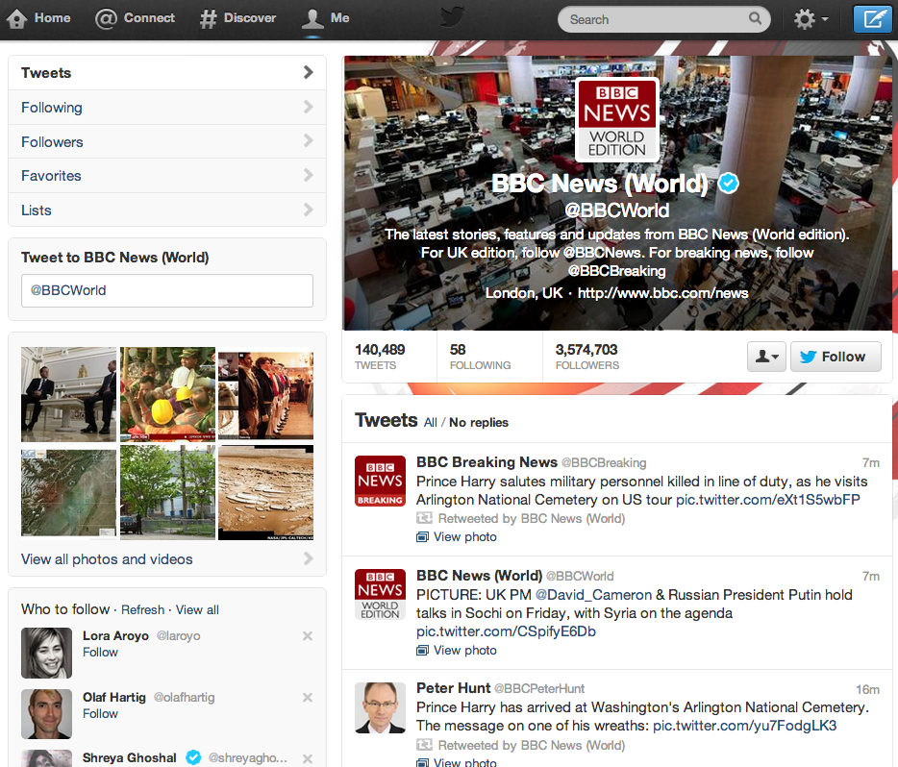
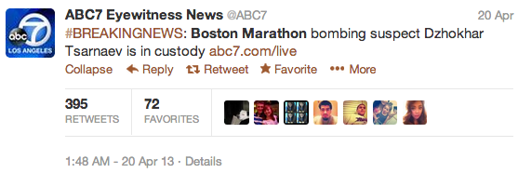
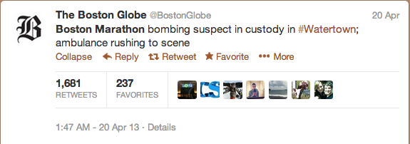
Social Media – Users and Content
User
Tweets

Slide 6
Anatomy of a Profile

Slide 7
Anatomy of a Tweet

Slide 8
Approach 2: Data Consumption
Query
Exploit Categories, indices, structure of data
Provide meaningful representation of data
Visual
Interactive
Intuitive

Slide 9
Standalone vs Web
 | Standalone Application | Web – Based Application
Platform | Platform/System Specific | Generic, based on web-standards
Maintenance | Installations/updates in every computer | Installations/updates in one location
Ease of use | Access from individual computers | Access from any location
Access Control | Centralised | Centralised
Scalability | Ability to handle large datasets | Significantly improving
Interactions | Easy to handle but platform, language specific | Web standards ensure similar techniques are employed

Slide 10
Browser Graphics – HTML 5 Canvas
Canvas
Draw Objects using scripts
Static or Dynamic
Manipulate Pixels to create objects
No DOM operations
Interactions handled from canvas by reading mouse events
e.g: Processingjs, Chartjs

Slide 11
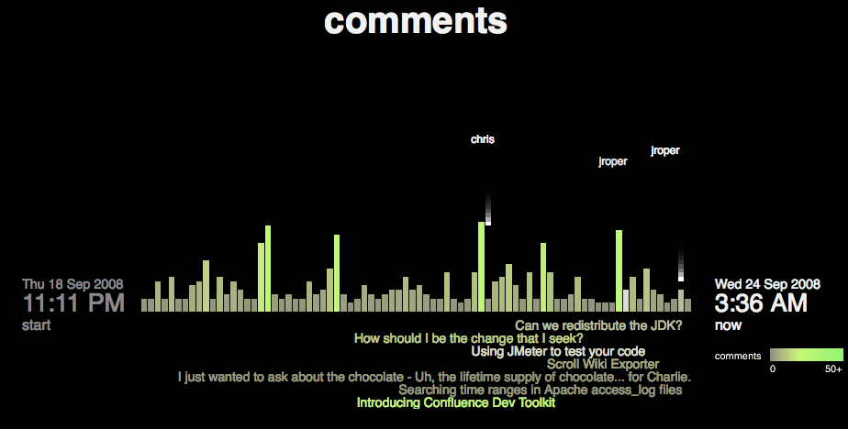
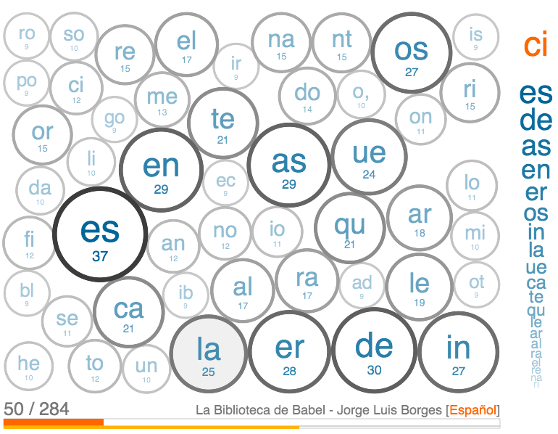
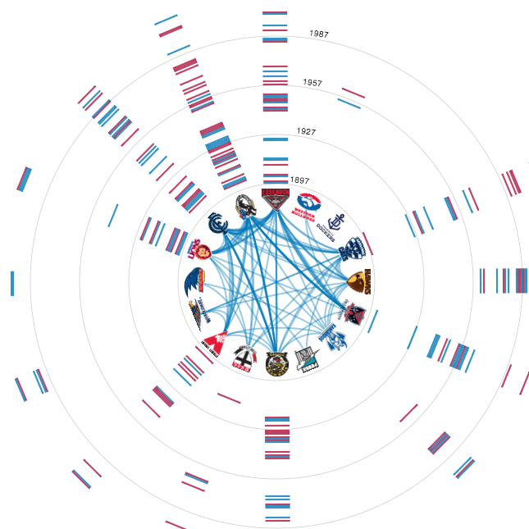
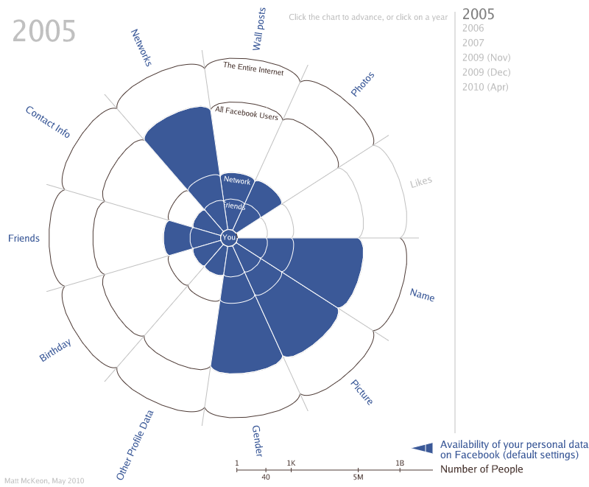
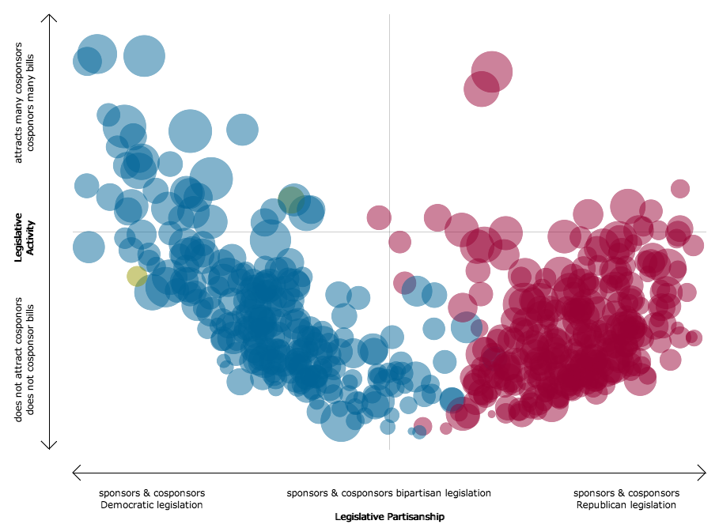
Processingjs
Port of the popular Processing graphics library

Slide 12
Browser Graphics – Scalable Vector Graphics
SVG
XML based (source file or script generated)
Static or Dynamic
Manipulation using DOM (Document Object Model, represent and interact with objects)
Easily add/remove SVG objects
Interactions handled by DOM events
e.g. Highcharts, d3js, JIT, gRaphaël, Google charts

Slide 13
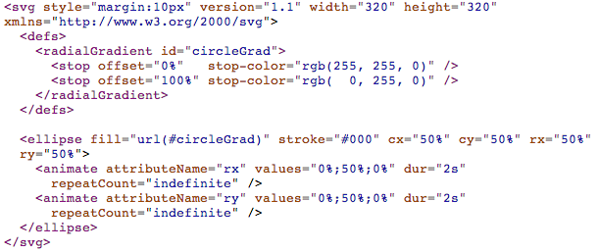
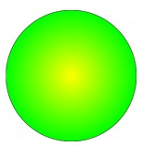
SVG Example

Slide 14
Canvas Example
window.addEventListener('load', function () {
// Get the canvas element.
var canvas = document.getElementById('myCanvas'),
w = 4,
h = 4,
zoompx = 6,
step = 'zoomin';
if (!canvas || !canvas.getContext) {
return;
}
// Get the canvas 2d context.
var ctx = canvas.getContext('2d');
if (!ctx) {
return;
}
var K = 4*((Math.SQRT2-1)/3);
setInterval(function () {
if (step == 'zoomin') {
w += zoompx;
h += zoompx;
} else if (step == 'zoomout') {
w -= zoompx;
h -= zoompx;
}
if (w > canvas.width) {
w = canvas.width;
step = 'zoomout';
} else if (w < 4) {
w = 4;
step = 'zoomin';
}
if (h > canvas.height) {
h = canvas.height;
step = 'zoomout';
} else if (h < 4) {
h = 4;
step = 'zoomin';
}
// Create the radial gradient: x0, y0, r0, x1, y1, r1.
// That's the start circle (x0,y0) coordinates and r0 radius,
// followed by the end circle (x1,y1) coordinates and r1 radius.
var gradient = ctx.createRadialGradient(
Math.round(w/2), Math.round(h/2), 0, Math.round(w/2), Math.round(h/2),
Math.round(Math.min(w, h)/2));
gradient.addColorStop(0, "#ff0");
gradient.addColorStop(1, "#0f0");
// Use the gradient for the fillStyle.
ctx.fillStyle = gradient;
// Ellipse radius and center.
var cx = w/2,
cy = h/2,
// Ellipse radius*Kappa, for the Bézier curve control points
rx = cx*K,
ry = cy*K;
ctx.setTransform(1, 0, 0, 1, 0, 0);
ctx.clearRect(0, 0, canvas.width, canvas.height);
ctx.setTransform(1, 0, 0, 1, Math.round((canvas.width - w) / 2),
Math.round((canvas.height - h) / 2));
ctx.beginPath();
// startX, startY
ctx.moveTo(cx, 0);
// Control points: cp1x, cp1y, cp2x, cp2y, destx, desty
// go clockwise: top-middle, right-middle, bottom-middle, then left-middle
ctx.bezierCurveTo(cx + rx, 0, w, cy - ry, w, cy);
ctx.bezierCurveTo(w, cy + ry, cx + rx, h, cx, h);
ctx.bezierCurveTo(cx - rx, h, 0, cy + ry, 0, cy);
ctx.bezierCurveTo(0, cy - ry, cx - rx, 0, cx, 0);
ctx.fill();
ctx.stroke();
ctx.closePath();
}, 20);
}, false);

Slide 15
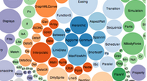
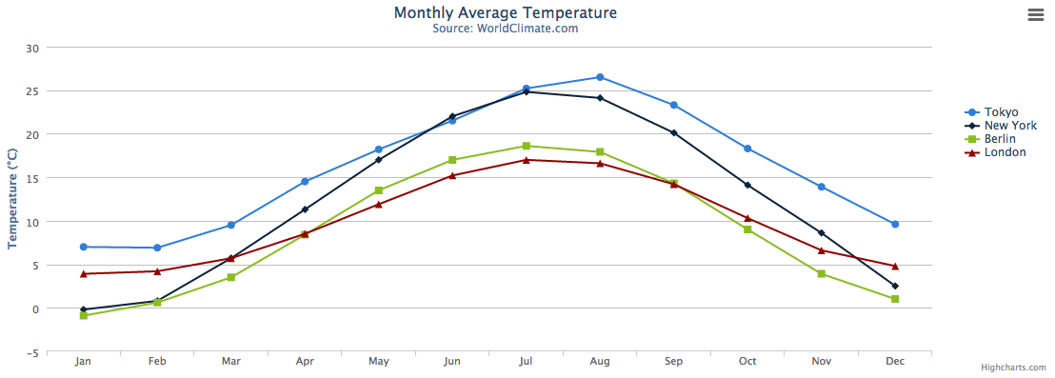
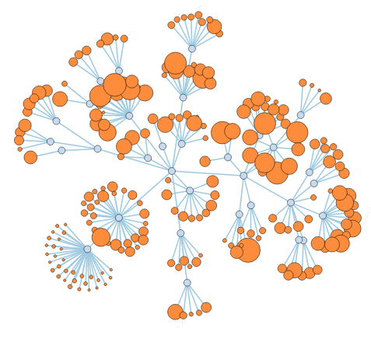
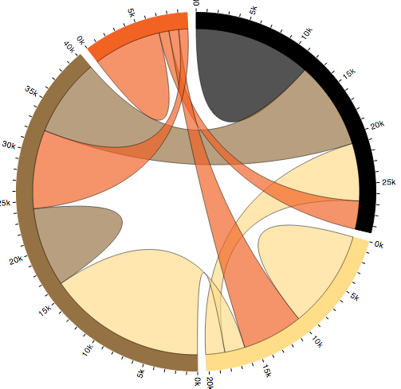
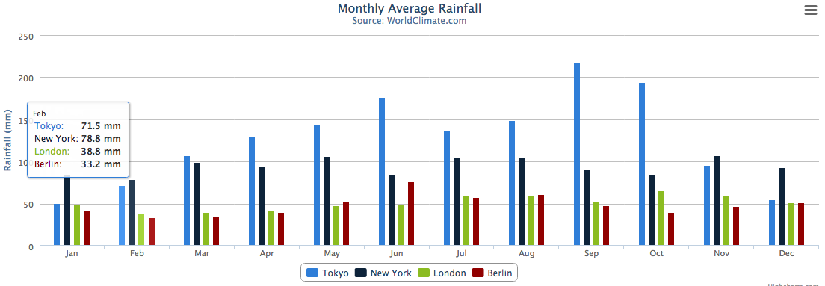
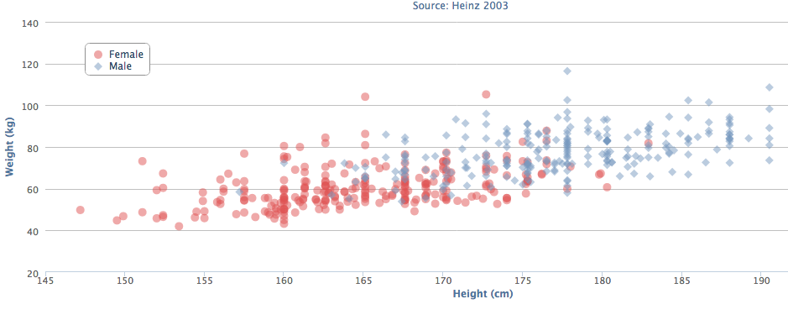
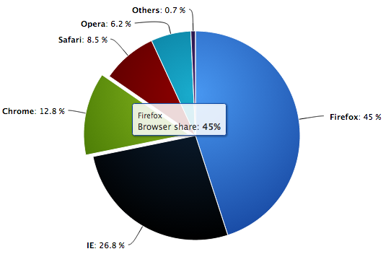
SVG Graphics

Slide 16
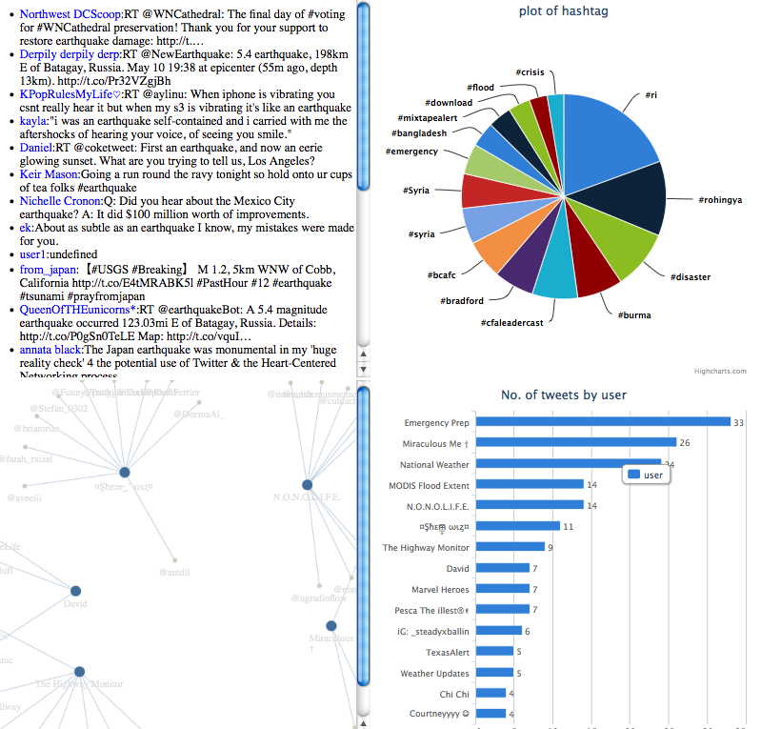
How to build a BASIC Interactive VA system

Slide 17





Typical Architecture
Client
User
Web Services
Server
Open Data
Client
Client
Structured Data
Client
Social Media

Slide 18
Tools/Libraries/Languages
HTML - web based framework for easy deployment and access
Javascript – client-side scripting to enable data and object manipulation
Jquery - javascript library providing event-handling, object manipulation, animation etc.
Charting Libraries
Highcharts (http://www.highcharts.com/)
D3js (http://d3js.org/)
Jit (http://philogb.github.io/jit/)

Slide 19
Data
3k Twitter posts, crawled over two days (keywords “emergency”,”crisis”,”disaster”,”flood”)
User names
Hashtags
Location
Source
Mentions
Content
Data stored in a local database (SOLR)
Easy to distribute with easy installation and access
Can be queried directly from js
Indexing technique favouring faceting, querying and pivoting

Slide 20
Techniques and Views
Visualisations
Pie Chart
TimeLine
Geo Map
ScatterPlot
Network
Interactions
Details-on-demand
Filter
Faceting
Pivoting

Slide 21
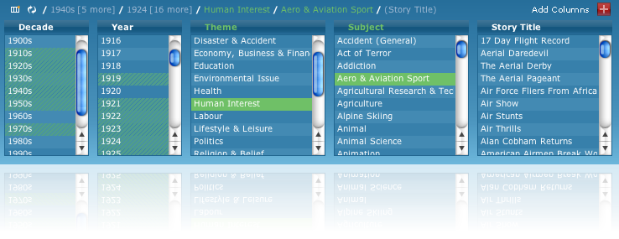
Faceted Search
Guided navigation
Incrementally reaching items of interest
Reduces need for complex querying

Slide 22
Pivot
Multi-dimensional faceting
Helps exploit multiple categorisations effectively
Support large range of visual paradigms

Slide 23
Step 0: Ensure Data is available at Solr
Download the SOLR folder
http://localhost:8983/solr
Download the tutorial materials

Slide 24
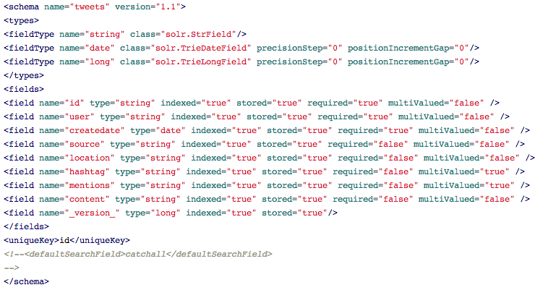
Data Schema

Slide 25
Step 1: Directory Structure
ROOT
|----> some_html_page.html
|----> js
|----> a_control_page.js
----> css
|----> a_base_css.css
|----> lib
|----> Highcharts-3.0.1
|----> Jit
|----> d3.v3

Slide 26
Step 2: Create an HTML file
<!DOCTYPE html>
<html>
<head>
<title>Example visualisations</title>
<meta http-equiv="Content-Type" content="text/html; charset=UTF-8">
</head>
<body>
<div id = “content”>
Content
</div>
</body>
</html>
index_basic.html

Slide 27
Step 3: Add Javascript files
<!DOCTYPE html>
<html>
<head>
<title>Example visualisations</title>
<meta http-equiv="Content-Type" content="text/html; charset=UTF-8">
<script language="javascript" type ="text/javascript" src="js/jquery.js"></script>
<script language="javascript" type ="text/javascript" src="js/control.js"></script>
</head>
<body>
</body>
</html>

Slide 28
Step 4: Add HTML Containers
<body>
<table>
<tr>
<td><div id=”container1" class="plot_holder"/></td>
<td><div id=”container2" class="plot_holder"/></td>
</tr>
<tr>
<td><div id=”container3" class="plot_holder"/></td>
<td><div id=”container4" class="plot_holder"/></td>
</tr>
</table>
</body>
</html>

Slide 29
Step 5: Add CSS
<!DOCTYPE html>
<html>
<head>
<title>Example visualisations</title>
<meta http-equiv="Content-Type" content="text/html; charset=UTF-8">
<script language="javascript" type ="text/javascript" src="js/jquery.js"></script>
<script language="javascript" type ="text/javascript" src="js/control.js"></script>
<link href=“css/base.css" rel="stylesheet">
</head>
<body>
</body>
</html>

Slide 30
Step 6: Add CSS (base.css)
.plot_holder{
background-color: silver;
border-color: black;
border-width: 1px;
min-height: 500px;
min-width: 500px;
width:42%;
}

Slide 31
Step 2: Display Tweets (control.js)
var solrUrl = http://localhost:8983/solr/tweets/select;
window.onload = function(){
listData();
}
function listData(){
var htmlstring="<ul>";
$.ajax({
'url': solrUrl,
'data': {'wt':'json','q':'*:*','rows':10},
'success': function(data) {
var docs = data.response.docs;
for (var docindex in docs){
htmlstring += "<li>"+docs[docindex].content+"<li>";
}
htmlstring+="</ul>";
document.getElementById(“container1").innerHTML=htmlstring;
},
'dataType': 'jsonp',
'jsonp': 'json.wrf'
});
}

Slide 32
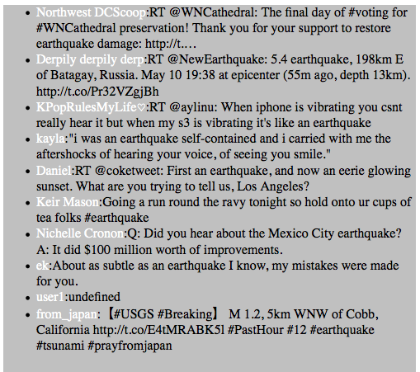

Slide 33
Visualisations
Visualise using Pie Chart,
Add Highcharts library to <head> in index_basic.html
Add relevant javascript code
Ideally, lookup demo code
Edit/manipulate for required view

Slide 34
Interactions ?
Click
Hover
Drag
Zoom
Pan
Keystrokes
hotkeys

Slide 35
Click
click: function(e) {
var value = "\""+e.point.category+"\"";
showDetails(barField,value);
}

